Slide 1



Sudesh Dattatray Patil
Exhaustive Analysis of Indian Agriculture

Slide 2

Learning Objectives
1️⃣ Data Visualization – Developed interactive charts and graphs to analyze Indian agricultural data. 2️⃣ Trend Analysis – Explored production trends over the years using line charts for better insights. 3️⃣ Comparative Analysis – Compared production across states, seasons, and crops using bar and pie charts. 4️⃣ Filtering & Interactivity – Implemented slicers for dynamic data exploration based on year and crop. 5️⃣ Data-Driven Decision Making – Gained insights into high-production states, major crops, and seasonal variations.
GOAL
Source :
www.freepik.com/

Slide 3
Tools and Technology used
1️⃣ Power BI – Used for data visualization, dashboard creation, and interactive analysis. 2️⃣ DAX (Data Analysis Expressions) – Applied for creating calculated fields, measures, and custom aggregations. 3️⃣ CSV (Comma-Separated Values) – The dataset was stored and processed in CSV format. 4️⃣ Data Cleaning & Transformation – Utilized Power Query Editor for handling missing values and data formatting. 5️⃣ Filters & Slicers – Implemented for dynamic data exploration and user interaction.

Slide 4
Methodology
Line Chart: Used to show the trend of agricultural production over time for different crops.
Data Represented: Sum of production by crop year.
Pie Chart: Used to represent the proportion of top 5 crops in total production.
Data Represented: Top 5 crops production.
Bar Chart: Used to represent the sum of production by state and the sum of production by season.
Data Represented:
Sum of production by state.
Sum of production by season.
Column Chart: Used to show the sum of production by crop.
Data Represented: Sum of production by crop.
Area Chart: Used to show the sum of area by state.
Data Represented: Sum of area by state.

Slide 5
Problem Statement:
Gain insights into the performance and trends of Indian agriculture.
Identify potential areas for improvement and development.
Support informed decision-making in the agriculture sector.

Slide 6
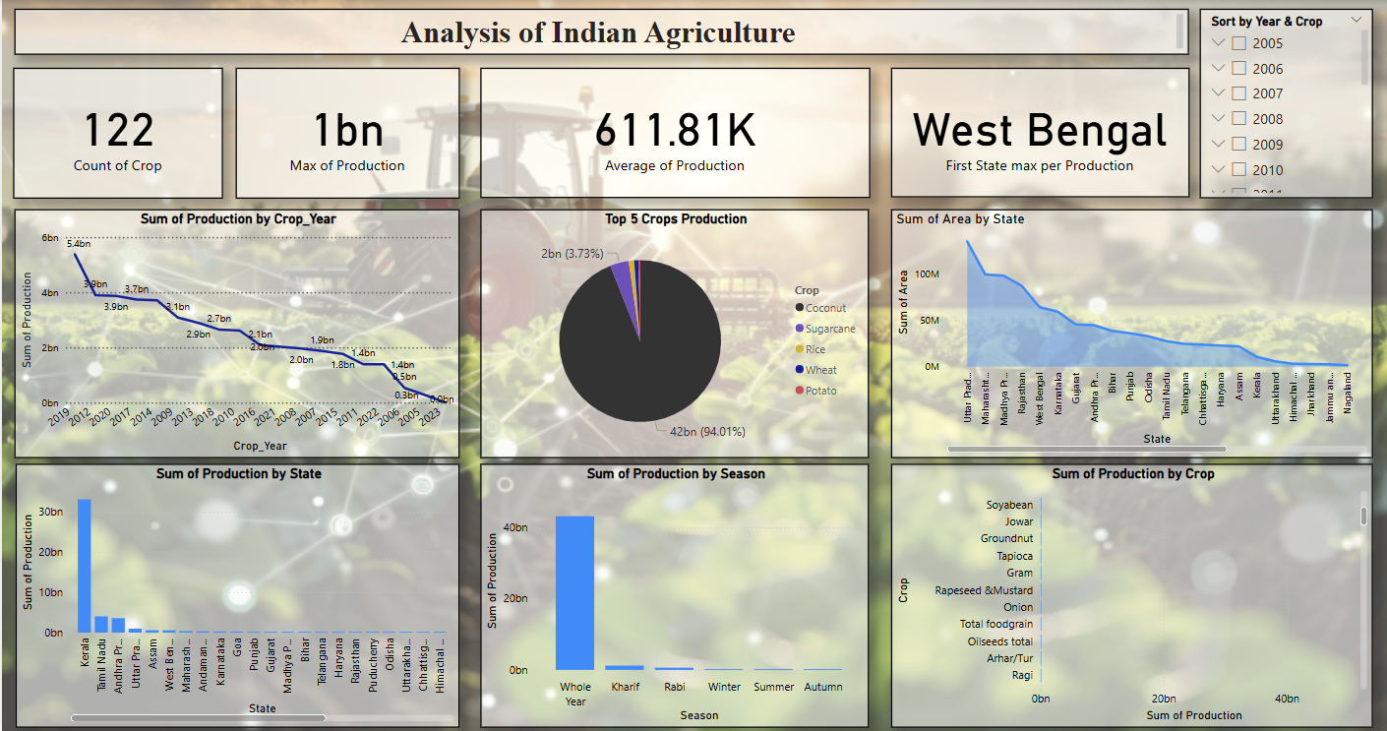
Screenshot of Output:

Slide 7
Conclusion:
Production Trend: Total crop production in India has been on a declining trend since 2012, with a slight bump in 2017, before reaching its lowest point in 2022.
Production by State: Kerala leads in total crop production followed by Tamil Nadu and Uttar Pradesh.
Top 5 Crops: Wheat contributes the highest percentage of production (94.01%), followed by Coconut, Sugarcane, Rice, and Potato.
Production by Season: The whole year production contributes significantly to the total production, while the Kharif season contributes slightly.
Area by State: Uttar Pradesh has the highest sum of area, followed by Madhya Pradesh and Rajasthan.

